Slide 1
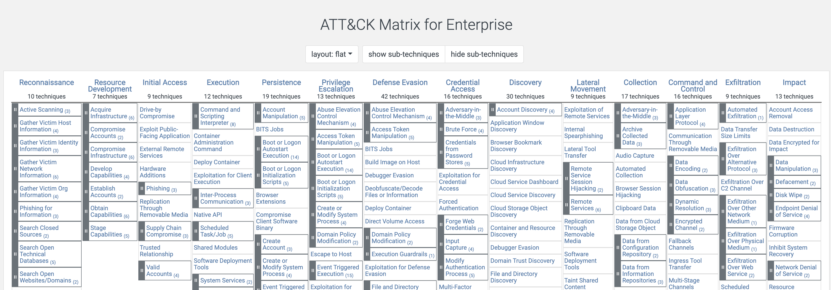
MITRE ATT&CK
https://attack.mitre.org/
Today we will be covering Credential Access.

Slide 2
Overall Flow: Discovery, Credential Access and Lateral Movement

Slide 3

Overall Flow
Lateral Movement
Discovery
Credential Access

Slide 4
Credential Access

Slide 5

Why does the attacker care about credential access, if they have already compromised a system?
Credentials are key to expanding reach in an environment:
Fully compromising a system usually has limited intrinsic value.
Usually, the system used for initial access does not have the capabilities for the attacker to accomplish their objectives.
Having to re-exploit each system they need to control, individually would become tedious and noisy (increasing odds of getting stopped).
Instead, the goal is to have the ability to use or impersonate powerful accounts, to carry out objectives using administrative capabilities innate to the target environment.
This Photo by Unknown Author is licensed under CC BY-NC-ND

Slide 6

What is Credential Access?
It is hijacking the ability to effectively use accounts that do not belong to the attacker, via a variety of methods.
On a more practical level, it comes down to enumerating and discovering accounts, followed by compromising those needed to succeed (in the attack).
It can flow in the opposite direction as well – compromise what you can and see what you happen to have.

Slide 7

A Few Key Techniques
Adversary-in-the-Middle
Brute Force
OS Credential Dumping
Obtain Credentials from Password Stores
Cracking hashes / brute forcing offline vaults.
Input Capture
Session Hijacking
Locate Unsecured Credentials
This Photo by Unknown Author is licensed under CC BY-NC

